Slide 1

Bonding Review for Fun and Enjoyment
What you need to know
in order to become the
best person you can be.
No kidding.
Get a Periodic Table now.

Slide 2
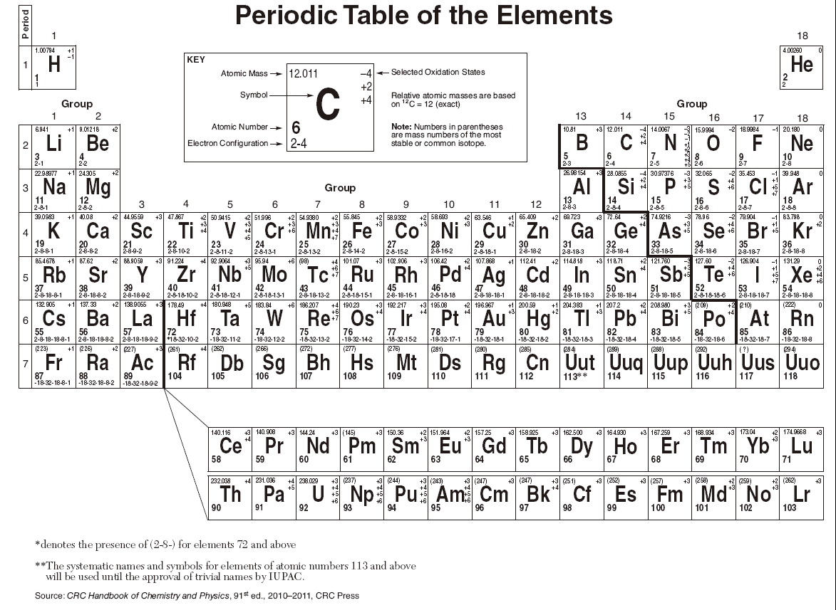
This is your table, minus the inner transitional elements,
so you can focus on the TOP part,
where ALL high school bonding happens.

Slide 3
Group 1 Metals all have one valence electron, all make only +1 Cations
Li⁺¹
Na ⁺¹
K ⁺¹
Rb ⁺¹
Cs ⁺¹
Fr ⁺¹

Slide 4
Group 2 Metals all have two valence electrons, all make only +2 Cations
Be⁺²
Mg⁺²
Ca⁺²
Sr⁺²
Ba⁺²
Ra⁺²
Group 1 Metals all have one valence electron, all make only +1 Cations
Li⁺¹
Na⁺¹
K⁺¹
Rb⁺¹
Cs⁺¹
Fr⁺¹

Slide 5
Group 2 Metals all have two valence electrons, all make only +2 Cations
Be⁺² Al only makes
Mg⁺² +3 cations
Ca⁺² Al⁺³
Sr⁺²
Ba⁺²
Ra⁺²
Group 1 Metals all have one valence electron, all make only +1 Cations
Li⁺¹
Na⁺¹
K⁺¹
Rb⁺¹
Cs⁺¹
Fr⁺¹

Slide 6
Group 2 Metals all have two valence electrons, all make only +2 Cations
Be⁺² Al only makes
Mg⁺² +3 cations
Ca⁺² Al⁺³
Sr⁺²
Ba⁺²
Ra⁺²
Group 15 nonmetals
all have five valence electrons, all make only
–3 anions
N⁻³ P⁻³ As⁻³
Group 1 Metals all have one valence electron, all make only +1 Cations
Li⁺¹
Na⁺¹
K⁺¹
Rb⁺¹
Cs⁺¹
Fr⁺¹

Slide 7
Group 2 Metals all have two valence electrons, all make only +2 Cations
Be⁺² Al only makes
Mg⁺² +3 cations
Ca⁺² Al⁺³
Sr⁺²
Ba⁺²
Ra⁺²
Group 15 nonmetals
all have five valence electrons, all make only
–3 anions
N⁻³ P⁻³ As⁻³
Group 16 nonmetals
all have six valence electrons, all make only –2 anions
O⁻² S⁻³ Se⁻³ Te⁻³
Group 1 Metals all have one valence electron, all make only +1 Cations
Li⁺¹
Na⁺¹
K⁺¹
Rb⁺¹
Cs⁺¹
Fr⁺¹

Slide 8
Group 2 Metals all have two valence electrons, all make only +2 Cations
Be⁺² Al only makes
Mg⁺² +3 cations
Ca⁺² Al⁺³
Sr⁺²
Ba⁺²
Ra⁺²
Group 15 nonmetals
all have five valence electrons, all make only
–3 anions
N⁻³ P⁻³ As⁻³
Group 16 nonmetals
all have six valence electrons, all make only –2 anions
O⁻² S⁻³ Se⁻³ Te⁻³
Group 1 Metals all have one valence electron, all make only +1 Cations
Li⁺¹
Na⁺¹
K⁺¹
Rb⁺¹
Cs⁺¹
Fr⁺¹
Group 17 nonmetals all
have seven valence electrons, all make only
– 1 Cations
F⁻¹
Cl⁻¹
Br⁻¹
I⁻¹

Slide 9

Noble Gases of Group 18, do not tend to make any ions at all.
They are “perfect”, and have no tendency to gain electrons
(they can’t really, their shells/orbitals are all full),
nor “lose” electrons (why bother, why become less stable?).

Slide 10
H is a freak…
It does not form by making ions, but when a hydrogen compounds
like HCl or HF goes into water,
it “unbonds” like
it’s a group 1 metal, it forms
the H⁺¹ cation.
ACIDS have
H⁺¹_{(AQ)}
cations,
which are
way cool.

Slide 11
The main ways atoms bond together are IONIC & COVALENT
IONIC | COVALENT

Slide 12
The main ways atoms bond together are IONIC & COVALENT
IONIC | COVALENT
Metals “lose” electrons, which get transferred to the nonmetals. Nonmetals “gain” electrons. | Electrons are not transferred, they are shared between ONLY NONMETAL ATOMS.

Slide 13
The main ways atoms bond together are IONIC & COVALENT
IONIC | COVALENT
Metals “lose” electrons, which get transferred to the nonmetals. Nonmetals “gain” electrons. | Electrons are not transferred, they are shared between ONLY NONMETAL ATOMS.
Metal CATIONS are + charged nonmetal ANIONS are – charged Ionic compounds are always neutral when bonded The positive and negative charges perfectly balance. | Nonmetals combine in ratios that always have the “selected oxidation numbers” sum to zero. They do not have charges even though they are positive and negative numbers.

Slide 14
The main ways atoms bond together are IONIC & COVALENT
IONIC | COVALENT
Metals “lose” electrons, which get transferred to the nonmetals. Nonmetals “gain” electrons. | Electrons are not transferred, they are shared between ONLY NONMETAL ATOMS.
Metal CATIONS are + charged nonmetal ANIONS are – charged Ionic compounds are always neutral when bonded The positive and negative charges perfectly balance. | Nonmetals combine in ratios that always have the “selected oxidation numbers” sum to zero. They do not have charges even though they are positive and negative numbers.
CATIONS and ANIONS are always isoelectric to noble gases. IONS always have “perfect” electron orbitals, just like the noble gases do. | By sharing their electrons in covalent bonds, the nonmetals get perfect outer orbitals sometimes. Because they are sharing their valence electrons, sometimes one atom gets the perfect octet, and sometimes it’s the other atom in the bond.

Slide 15
Drills.
Think and decide, then see if you are correct by clicking ahead…

Slide 16
How many bonds can the halogens of group 17 make?

Slide 17
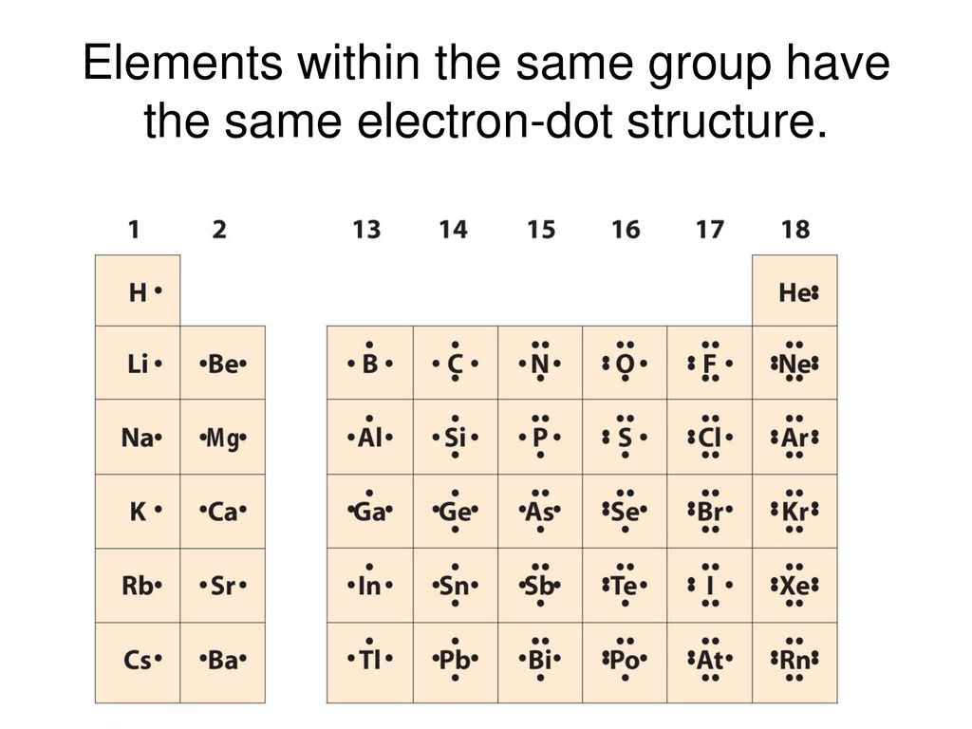
How many bonds can the halogens of group 17 make?
ONE. They all have 7 valence electrons,
they can only borrow 1 to get their octet.

Slide 18
How many bonds can the ATOMS of group 15 make?

Slide 19
How many bonds can the ATOMS of group 15 make?
THREE. They all have 5 valence electrons,
they MUST borrow 3 to get their octet.
THREE SINGLE BONDS, and/or
“N” CAN MAKE A TRIPLE BOND.

Slide 20
How many bonds can the ATOMS of group 16 make?

Slide 21
How many bonds can the ATOMS of group 16 make?
TWO. They all have 6 valence electrons,
they MUST borrow 2 to get their octet.
TWO SINGLE BONDS,
and “O” CAN MAKE A DOUBLE BOND.

Slide 22
Which atoms can make single bonds?

Slide 23
Which atoms can make single bonds?
H… has one e – , needs one e– to fill up the first orbital

Slide 24
Which atoms can make single bonds?
H… has one e – , needs one e– to fill up the first orbital
F, Cl, Br, and I… they have 7 outer electrons, they need to
borrow one to get a full valence orbital.

Slide 25
Which atoms can make single bonds?
H… has one e – , needs one e– to fill up the first orbital
F, Cl, Br, and I… they have 7 outer electrons, they need to
borrow one to get a full valence orbital.
O, S, Se, and Te… they have 6 valence electrons and
MUST make 2 bonds to be “complete”.
They can make 2 single bonds to do this. Oxygen can also make double bonds. Double bonds for the others are less common in HS Chem.

Slide 26
Which atoms can make single bonds?
H… has one e – , needs one e– to fill up the first orbital
F, Cl, Br, and I… they have 7 outer electrons, they need to borrow one to get a full valence orbital.
O, S, Se, and Te… they have 6 valence electrons and MUST make 2 bonds to be “complete”.
They can make 2 single bonds to do this. Oxygen can also make double bonds. Double bonds for the others are less common in HS.
N, P, and As have 5 valence electrons, and must make
three bonds in total to get a complete outer orbital.
Nitrogen can also make a triple bond. P and As do not make triple bonds in HS chem.

Slide 27
Which atoms can make single bonds?
H… has one e – , needs one e– to fill up the first orbital
F, Cl, Br, and I… they have 7 outer electrons, they need to borrow one to get a full valence orbital.
O, S, Se, and Te… they have 6 valence electrons and MUST make 2 bonds to be “complete”.
They can make 2 single bonds to do this. Oxygen can also make double bonds. Double bonds for the others are less common in HS.
N, P, and As have 5 valence electrons, and must make three bonds to get a complete outer orbital.
Nitrogen can also make a triple bond. P and As do not make triple bonds in HS chem.
Carbon and Silicon each have 4 valence electrons.
They can make 4 single bonds, or 2 double bonds.

Slide 28
Which atoms can make single bonds?
H… has one e – , needs one e– to fill up the first orbital
F, Cl, Br, and I… they have 7 outer electrons, they need to borrow one to get a full valence orbital.
O, S, Se, and Te… they have 6 valence electrons and MUST make 2 bonds to be “complete”.
They can make 2 single bonds to do this. Oxygen can also make double bonds. Double bonds for the others are less common in HS.
N, P, and As have 5 valence electrons, and must make three bonds to get a complete outer orbital.
Nitrogen can also make a triple bond. P and As do not make triple bonds in HS chem.
Carbon and Silicon each have 4 valence electrons.
They can make 4 single bonds, or 2 double bonds.
Carbon can also make a triple bond and a single bond, or
a double bond and two single bonds (wow)

Slide 29
Which atoms can make single bonds?
H… has one e – , needs one e– to fill up the first orbital
F, Cl, Br, and I… they have 7 outer electrons, they need to borrow one to get a full valence orbital.
O, S, Se, and Te… they have 6 valence electrons and MUST make 2 bonds to be “complete”.
They can make 2 single bonds to do this. Oxygen can also make double bonds. Double bonds for the others are less common in HS.
N, P, and As have 5 valence electrons, and must make three bonds to get a complete outer orbital.
Nitrogen can also make a triple bond. P and As do not make triple bonds in HS chem.
Carbon and Silicon each have 4 valence electrons. They can make 4 single bonds, or 2 double bonds.
Carbon can also make a triple bond and a single bond, or a double bond and two single bonds (wow)
Finally, it rhymes with moron… BORON has 3 valence electrons. It makes 3 single bonds.
It ends up with LESS than a full octet of electrons, it’s exceptional.

Slide 30
Which atoms can make single bonds?
Metals bond by forming into cations, and bond only to nonmetals that form into anions.
These bonds are not “single”, or double or triple.
They are JUST IONIC.

Slide 31
Which atoms can make single bonds?
Metals bond by forming into cations, and bond only to nonmetals that form into anions.
These bonds are not “single”, or double or triple.
They are JUST IONIC.
Single bonds share one pair of electrons. Double bonds share 2 pairs of electrons. Triple bonds share 3 pairs of electrons. Ionic bonds DO NOT SHARE ELECTRONS.

Slide 32
Which atoms can make double bonds?

Slide 33
Which atoms can make double bonds?
Oxygen can make a double bond (or 2 single bonds)
Silicon also can make two double bonds.
Nitrogen can make a double and single bond.
Carbon can make 2 double bonds, or one double bond with two single bonds.

Slide 34
Which atoms can make triple bonds?

Slide 35
Which atoms can make triple bonds?
Nitrogen makes triple bonds,
Carbon makes triple bonds, but…
Carbon making a triple bond means is must also make a single bond. Carbon must always make 4 bonds.

Slide 36
Carbon must make 4 covalent bonds, how does it bond to hydrogen and the halogens?

Slide 37
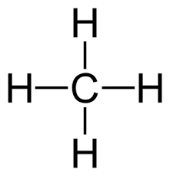

Carbon must make 4 covalent bonds, how does it bond to hydrogen and the halogens?

Slide 38
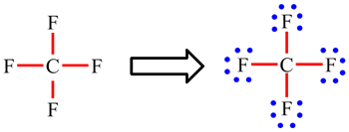
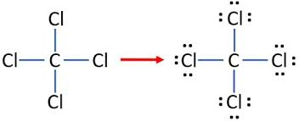
Carbon must make 4 covalent bonds, how does it bond to hydrogen and the halogens?

Slide 39
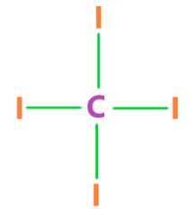

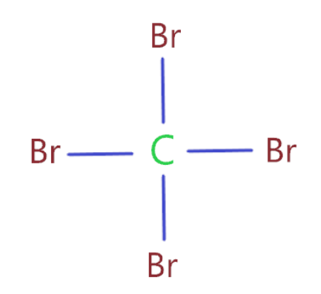
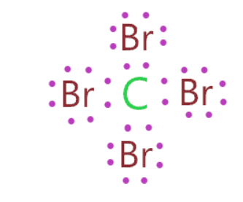
Carbon must make 4 covalent bonds, how does it bond to hydrogen and the halogens?

Slide 40
How does oxygen bond? It has 6 valence electrons…

Slide 41
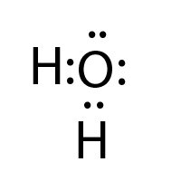
How does oxygen bond? It has 6 valence electrons…
Water has oxygen making 2 single bonds.

Slide 42
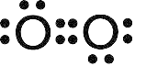
How does oxygen bond? It has 6 valence electrons…
Water has oxygen making 2 single bonds.
O₂ has oxygen making a double bond.

Slide 43
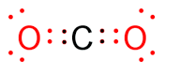
How does oxygen bond? It has 6 valence electrons…
Water has oxygen making 2 single bonds.
O₂ has oxygen making a double bond.
Carbon dioxide also.

Slide 44
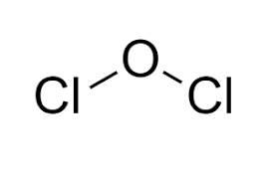
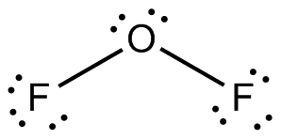
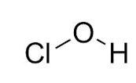
How does oxygen bond? It has 6 valence electrons…
Oxygen must make 2 bonds, two singles, or a double.
Either way, it needs to “borrow” 2 electrons to get its octet.

